Slide 1


The JavaScript Language
An Introduction
ATTILA GYÖNGYÖSI
OCTOBER 12, 2016

Slide 2

AGENDA
What is JavaScript?
Identifiers & Control Flow
Data Types & Operations
Scopes
Callbacks & IIFEs
JSON
Timers
DOM Events
Exercises!
Notes:
P37 – divide into 2 slides

Slide 3

JavaScript – An Introduction
What is
Javascript?

Slide 4

WHAT IS JAVASCRIPT?
A programming language, duh
Created by Brendan Eich in May 1995
NOT Java
High-level
Dynamic
Prototype-based
Weakly typed
Interpreted
Standardized in ECMAScript Current version is Edition 7
Notes:
P37 – divide into 2 slides

Slide 5
JavaScript – An Introduction
IDENTIFIERS
& control flow

Slide 6
IDENTIFIERS & CONTROL FLOW
IDENTIFIERS
The name of variables, functions and keywords
Must start with a letter, underscore (_) or dollar sign ($)
Can be followed by numbers, letters, underscores and dollar signs
Are case sensitive awYeah != awYEAH
Convention: camelCase var funTime = true;
Notes:
P37 – divide into 2 slides

Slide 7
IDENTIFIERS & CONTROL FLOW
CONTROL FLOW
Control flow statements are similar to other high-level languages
Branching
if / else if / else
switch / case
Loops
for
while
do .. while
Notes:
P37 – divide into 2 slides

Slide 8
JavaScript – An Introduction
DATA TYPES
& OPERATIONS

Slide 9
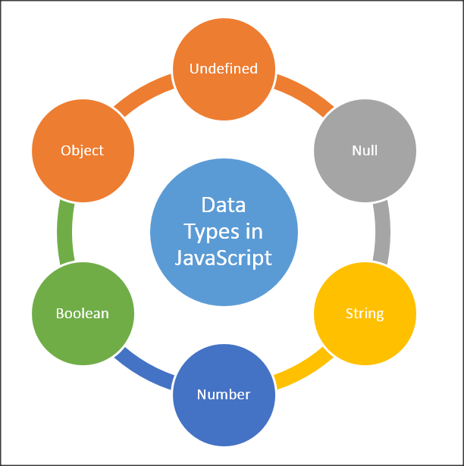
DATA TYPES & OPERATIONS
PRIMITIVE TYPES
Null Has only one value: null
undefined New variables that haven’t been assigned a value
Boolean Logical value; true or false
Number 12, 42.01 Internally only floating point
String Textual data: ”antidisestablishmentarianism”
Notes:
P37 – divide into 2 slides

Slide 10
DATA TYPES & OPERATIONS
COMPLEX TYPES
Object A collection of properties (key-value pairs) { id: 1, howMuchIsTheFish: ”nana-nananana”, isButAScratch: true, innerObject: { x: [1, ’x’] } }
Notes:
P37 – divide into 2 slides

Slide 11
DATA TYPES & OPERATIONS
LITERALS
Literals are fixed values within the code.
Integer literals
Decimal 12
Leading 0 / 0o / 0O: octal 007
Leading 0x / 0X: Hexadecimal 0xAF1
Leading 0b / 0B: Binary 0b001001
Notes:
P37 – divide into 2 slides

Slide 12
DATA TYPES & OPERATIONS
LITERALS
Floating-point literals [(+|-)][digits][.digits][(E|e)[(+|-)]digits]
Decimal integer
Floating point (.)
Fraction (decimal)
Exponent (decimal)
Boolean literals: true and false
String literals Zero or more characters enclosed in ’’ or ”” ’I am a string literal, yo’ ”Me too, buddy”
Notes:
P37 – divide into 2 slides

Slide 13
DATA TYPES & OPERATIONS
LITERALS
Object literals Zero or more property names with their associated values, separated by commas, enclosed in { and }
var o = {
isLiteral: true,
talkAboutFightClub: false
}
o.isLiteral // true
o[’talkAboutFightClub’] // false
Notes:
P37 – divide into 2 slides

Slide 14
DATA TYPES & OPERATIONS
LITERALS
Array literals Zero or more expressions enclosed in [ and ]
var a = [’Funk’, 12, true, {x: 11.0}];
a[1] // 12
Arrays are objects internally
a = {
0: ’Funk’,
1: 12,
2: true,
3: {x: 11.0}
}
Notes:
P37 – divide into 2 slides

Slide 15
DATA TYPES & OPERATIONS
OPERATING ON STRINGS
.length returns the length of the String. ’bird’.length; // 4
.split() splits the string into an array by the given separator ’apple’.split(); // [’a’, ’p’, ’p’, ’l’, ’e’] ’house cat’.split(’ ’) // [’house’, ’cat’]
.concat() concatenates multiple strings into one ’one’.concat(’ two’, ’three’); // ’one twothree’
.indexOf() Returns the index of the first occurrence of the specified value or -1 if not found ’funeral’.indexOf(’fun’) // 0
Notes:
P37 – divide into 2 slides

Slide 16
DATA TYPES & OPERATIONS
OPERATING ON BOOLEANS
Negation: !
Truthy: evaluates to true
Falsy: evaluates to false
Falsy values:
false
0
””
null
undefined
NaN (Not a Number)
Convert truthy/falsy to true/false !!falsyValue // false
Notes:
P37 – divide into 2 slides

Slide 17
DATA TYPES & OPERATIONS
OTHER OPERATIONS
Equality == / != - compares value only (typecasts) === / !== - compares value and type
typeof Returns the type of the given expression as a String typeof 1; // ”number” typeof(null); // ”object”
parseInt(string, base) Converts a string to an integer in a given base. Returns NaN if fails. parseInt(”5”, 10); // 5 parseInt(”bobby”, 2); // NaN
Notes:
P37 – divide into 2 slides

Slide 18
JavaScript – An Introduction
scopes

Slide 19
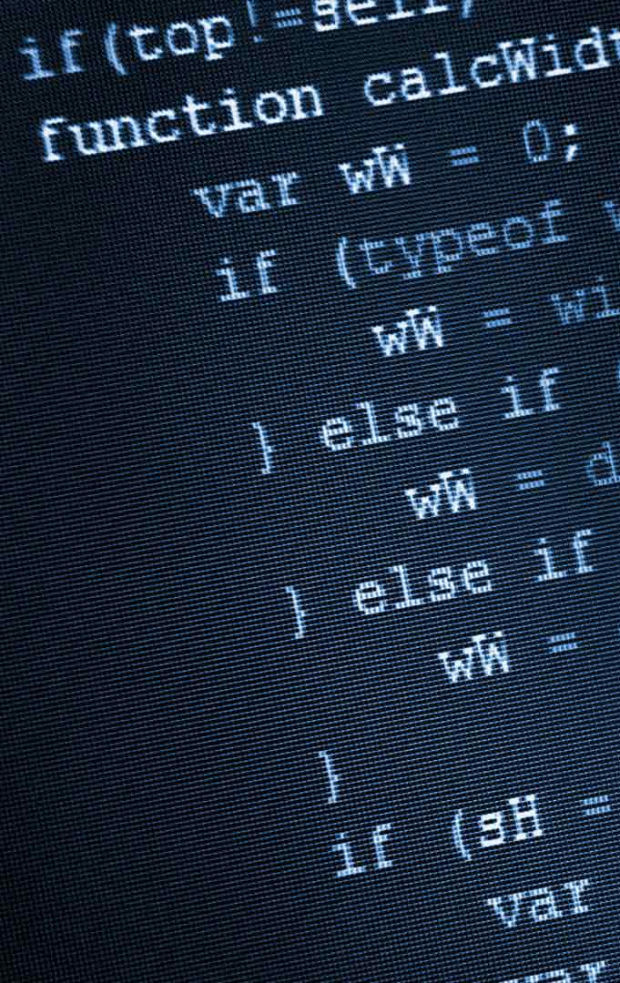
SCOPES
Scope: a segment of code where a variable or a function is accessible
Unlike many other languages, JavaScript originally had no block scoping, only available from ES6
The var keyword
Global scope vs. Function scope
Notes:
P37 – divide into 2 slides

Slide 20
SCOPES
GLOBAL SCOPE
A variable declared outside of a function or without the var keyword will be on the global scope
FUNCTION SCOPE
Variables declared inside functions will be on the function’s scope and only visible inside that function and in its nested functions.
Notes:
P37 – divide into 2 slides

Slide 21
SCOPES
HOISTING
In JavaScript, a variable can be declared after it has been used x = 5; console.log(x); // 5 var x;
JavaScript has a default behavior to move every declaration to the top of the current scope. This is called hoisting. var x; x = 5; console.log(x); // 5
Notes:
P37 – divide into 2 slides

Slide 22
SCOPES
HOISTING
Source code | After hoisting
test(); // 'test1' function test() { console.log('test1'); } var test = function() { console.log('test2'); }; | function test() { console.log('test1'); } var test; test(); test = function() { console.log('test2'); };
Notes:
P37 – divide into 2 slides

Slide 23
JavaScript – An Introduction
callbacks & IIFEs

Slide 24
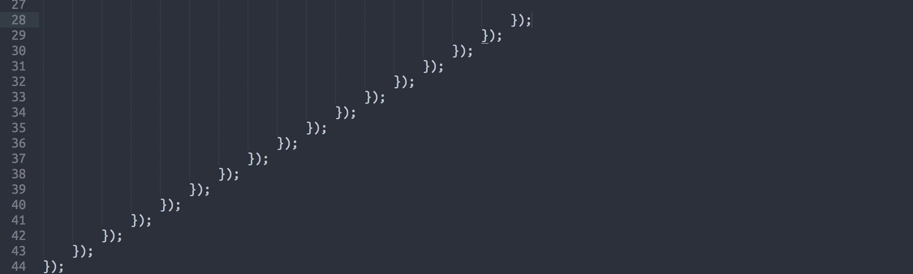
CALLBACKS& IIFEs
In JavaScript, functions can be used in a very flexible manner
Functions are first-class citizens of the language:
they do not have any special status and are treated just like variables
you can pass them as arguments to other functions
you can return them from other functions
can store them in variables and data structures
Notes:
P37 – divide into 2 slides

Slide 25
CALLBACKS & IIFEs
CALLBACKS
Callbacks are essentially function arguments passed to another function, to be called at some point.
Notes:
P37 – divide into 2 slides

Slide 26
CALLBACKS & IIFEs
CALLBACKS
Callbacks are essentially function arguments passed to another function, to be called at some point. funkyTown(true, groove); function funkyTown(isFunk, cb) { console.log(’Funk? ’, isFunk); cb(’nananana’); } function groove(message) { console.log(message); }
Notes:
P37 – divide into 2 slides

Slide 27
CALLBACKS & IIFEs
IIFE
IIFE = Immediately Invoked Function Expression
A special construct and design pattern in JavaScript
Is a function that is called and executed immediately
Notes:
P37 – divide into 2 slides

Slide 28
CALLBACKS & IIFEs
IIFE
(function(x) { console.log(’x:’, x);
}(8)); // x: 8
var f = function(x) { console.log(’x:’, x);
}(’cat’); // x: ’cat’
Notes:
P37 – divide into 2 slides

Slide 29
CALLBACKS & IIFEs
IIFE
But why?
To not pollute global scope
To hide functions/variables while exposing others
To better separate code
Notes:
P37 – divide into 2 slides

Slide 30
JavaScript – An Introduction
JSON

Slide 31

JSON
JSON = JavaScript Object Notation
A lightweight data interchange format
Readable to humans
Easily processed by programs
Like XML
A subset of JavaScript
Notes:
P37 – divide into 2 slides

Slide 32
JSON
MIME type is application/json
Can contain the following types:
Number
String
Boolean
Array
null
You can validate JSON against a schema (a special JSON)
Notes:
P37 – divide into 2 slides

Slide 33
JSON
{
”id”: 1,
”name”: ”Json Statham”,
”hasGun”: true, ”movies”: [
”Crank”,
”The Transporter”
]
}
Notes:
P37 – divide into 2 slides

Slide 34
JSON
Parsing JSON
eval() Risky! Could execute unwanted code!
JSON.parse() Since ES5. Parses a JSON string into an object. var d = '{"name": "John Doe", "age": 22 }'; var jsObject = JSON.parse(d); console.log(jsObject.name + ' ' + jsObject.age); // 'John Doe 22'
Notes:
P37 – divide into 2 slides

Slide 35
JavaScript – An Introduction
timers

Slide 36
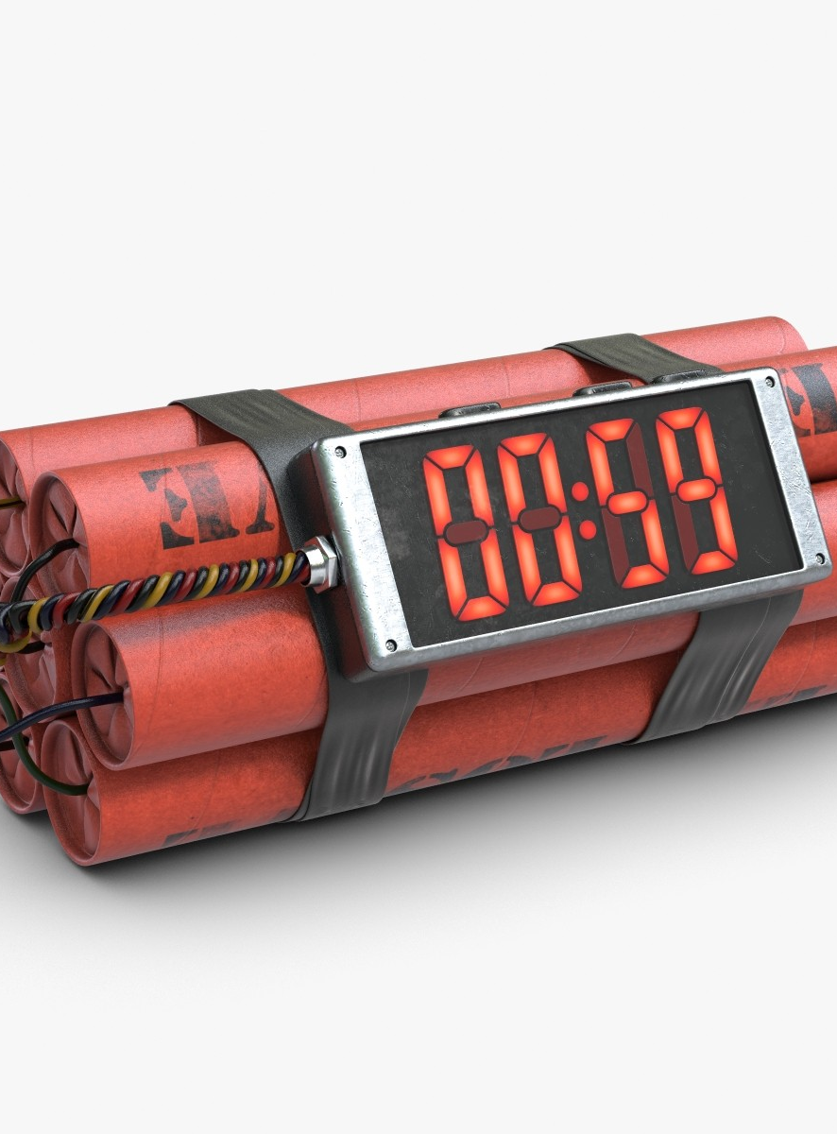
TIMERS
JavaScript execution in the browser is synchronous by default
There are ways to delay or schedule execution of code
Once, after an amount of time
Periodically
Notes:
P37 – divide into 2 slides

Slide 37
TIMERS
Once, after a given amount of time
window.setTimeout(function () {
console.log('Disco!');
}, 1000);
Periodically
window.setInterval(function () {
console.log('Party!');
}, 5000);
Notes:
P37 – divide into 2 slides

Slide 38
TIMERS
Stopping execution
var intvl = window.setInterval(function () {
console.log('Party!');
}, 5000);
window.clearInterval(intvl);
var timer = window.setTimeout(function () {
console.log(’Timeout!');
}, 1000);
window.clearTimeout(timer);
Notes:
P37 – divide into 2 slides

Slide 39
JavaScript – An Introduction
DOM events

Slide 40
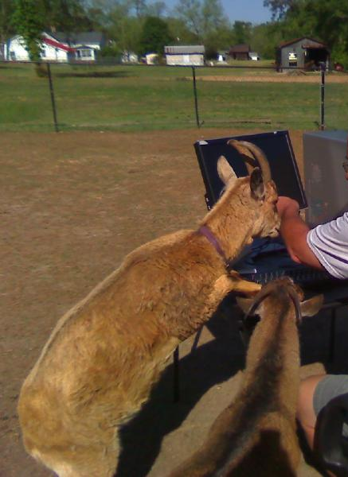
DOM EVENTS
When interacting with web pages in a browser, various things can happen. These are called events and you can execute JavaScript code when events happen.
You can programatically react to browser events and create event-driven applications.
Notes:
P37 – divide into 2 slides

Slide 41
DOM EVENTS
COMMON EVENTS
onload fired by the browser when the HTML document finished loading
onclick an HTML element fires an onclick event when the user clicks on it
Notes:
P37 – divide into 2 slides

Slide 42
DOM EVENTS
COMMON EVENTS
onmouseover?
onmouseleave?
onkeydown?
onchange?
Notes:
P37 – divide into 2 slides

Slide 43
DOM EVENTS
COMMON EVENTS
onmouseover when user hovers over an element
onmouseleave when the pointer leaves the element
onkeydown when a key is pressed
onchange when a form input’s value changes
Notes:
P37 – divide into 2 slides

Slide 44
DOM EVENTS
EVENT HANDLING IN THE DOM
HTML: <nav onclick=”someJSFunction()”> </nav>
JS:
function someJSFunction() {
console.log(’Clicked nav, yo!’);
}
Notes:
P37 – divide into 2 slides

Slide 45
DOM EVENTS
’THIS’ OBJECT
this When given to a JavaScript event handler as a parameter, this represents the HTML element that fired the event
Notes:
P37 – divide into 2 slides

Slide 46
DOM EVENTS
’THIS’ OBJECT
HTML: <nav id=”someId” onclick=”someJSFunction(this)”> </nav>
JS:
function someJSFunction(this) {
console.log(this.getAttribute(’id’);
} // ’someId’
Notes:
P37 – divide into 2 slides

Slide 47
JavaScript – An Introduction
Exercises!

Slide 48
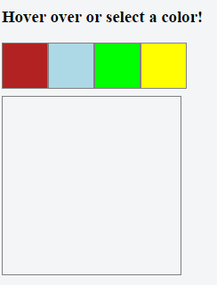
EXERCISES
Go to https://jsfiddle.net/
Create a simple web page like so ->
When user hovers over a colored box: Big box should change to that color
When user leaves a colored box: Big box should revert to its original color
When user clicks on a colored box: Big box’s color should be set to that color (and remain so)
Notes:
P37 – divide into 2 slides

Slide 49
EXERCISES
Data Manipulation
Given the following variables:
var attrs = 'name age city gender';
var values = [
['Joe', 22, 'New York City', 'male'],
['Jane', 85, 'Las Vegas', 'female'],
['Jack', 55, 'London', 'male']
];
Build the following structure (not by hand): var people = [
{name: 'Joe', age: 22, city: 'New York City', gender: 'male'},
{name: 'Jane', age: 85, city: 'Las Vegas', gender: 'female'},
{name: 'Jack', age: 55, city: 'London', gender: 'male'},
];
Notes:
P37 – divide into 2 slides

